Slide 1




SHINING BRIGHT
with a Property Services MIDDLEMAN Franchise

Slide 2




1st or 2nd income
A career to be proud of
Managed Solution
Building Services
Job
Estimates
As a Fixerly MIDDLEMAN, your business is to manage / coordinate the various aspects & stages of small – medium size property repair &maintenance jobs.
Use a mixture of sub-contractors across trades & perhaps a handyman on flexi hours to carry out the authorized works.
Easily provide estimates to your clients using simple to use templates. Adding images of the required work certainly make estimates SHINE.

Slide 3




FiXerly ‘MIDDLEMAN’
As the owner of a Fixerly franchise, you will be managing all aspects of each job. You do not do the work yourself, in essence you are the project / job manager.
Handyman
Insurance Claim Repairs
Building services
As a MIDDLEMAN you will manage and use your handyman
or small sub-contractor network
to carry out all types of handyman property repairs.
You will be the helpful LINK 🔗 between insurance companies, various trades & your clients. This type of work can be VERY lucrative ££.
The Fixerly network like small to medium size jobs that from experience are easier to manage with higher profit margins compared to big jobs.

Slide 4

How it works: 4 easy steps
Job Enquiry
Estimate
01
02
All work leads go DIRECT to you the local Fixerly MIDDLEMAN in a number of ways. In any business, leads & all job opportunities are generated from a multi-faceted approach
You get to choose if & when to visit a job to look at the required works for estimate purposes. A client may send you MMS, WA or email pictures so you do not need to travel to site so saving time & £
Authorization
Make Money
03
04
Local businesses & private clients will love your property service. Having someone managing all building & maintenance work / projects certainly will lead to lots of go-aheads of work for your Fixerly business
As a MIDDLEMAN, You will use a combination of handymen & 1 off trade specific people to carry out the work. As a baseline we recommend that you have at least 1 part time employed handyman or on a flexible hourly basis as needed to ensure quality & timely delivery of services.

Slide 5



Join us as a ‘Property Services MIDDEMAN’

Slide 6

Fixerly - meaning
“Financial
Incentive
X
Earned
Returns
Labor
Y-Value”
“
“

Slide 7

Financials
£99p/m
£2,995
£0
£
You pay zero royalty/commission 0% on your turnover or profit just £99 p/m (or £59 p/m yearly) for the franchise account maintenance fee which covers all your comprehensive on-going franchise assets. It covers your professional email system, webpage, trademark brand use, templates, business portal, Google & Bing SEO, HQ support, video hosting and so much more.
FIXERLY charges a one-off custom design & set up fee of £2,995 that gets you LIVE in business.
Never pay royalty or commission 0%. £0.
We are the first franchise in the UK to offer this unique ZERO royalty charge.
Just your home office / normal small business running costs typically incurred with running any business.

Slide 8

Timeline To Join & be LIVE
From placing your order & paying £2,995 you will receive an information sheet that collects specifics of what contact details, areas you want to offer services in.
Our business design team will craft & customize your very own unique FIXERLY MIDDLEMAN franchise. They do and create for you so much we are sure you will ‘Smile Forever’.
Week 1
Week 2
Each day our designers will be emailing your new dedicated business email. They will send you most elements daily as they create your business. They encourage you to look at, suggest a few tweaks and make final proofs.
After typically 7 working days your business will typically be fully customized & complete. After final checks with you it will all be made ‘LIVE’. You then will be given access to our online 'training & video area' which really is a great learning resource.
Week 1
Week 2

Slide 9

Your future career & income is looking BRIGHT

Slide 10
SHINING STRONG
You receive so much with a Fixerly MIDDLEMAN business that you need to take a LIVE look at what you will be receiving www.fixerly.co.uk/receives
www.fixerly.co.uk

Slide 11

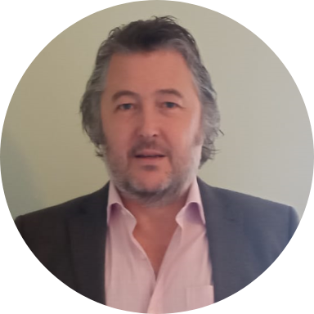

Questions?
More Information?
PC screen share DEMO?
Dominic Booth
founder Director
info@fixerly.co.uk
www.fixerly.co.uk
WhatsApp any time – 07837 290257
www.fixerly.co.uk/middleman

